Slide 1


Predictive Modeling of Energy Consumption in IoT Communication Networks
ARKA JAIN UNIVERSITY | IBM
Team members: Stuti Kumari - AJU/241581
Arjit Prakher - AJU/241367

Slide 2
The explosive growth of Internet of Things (IoT) networks poses a critical challenge: achieving energy efficiency and long-term sustainability.
Many IoT devices rely on finite battery power, making excessive energy consumption a direct threat to their operational lifespan, scalability, and maintenance costs.
The network's performance is determined by a complex interplay between device type, communication protocol, and environmental factors.
INTRODUCTION

Slide 3
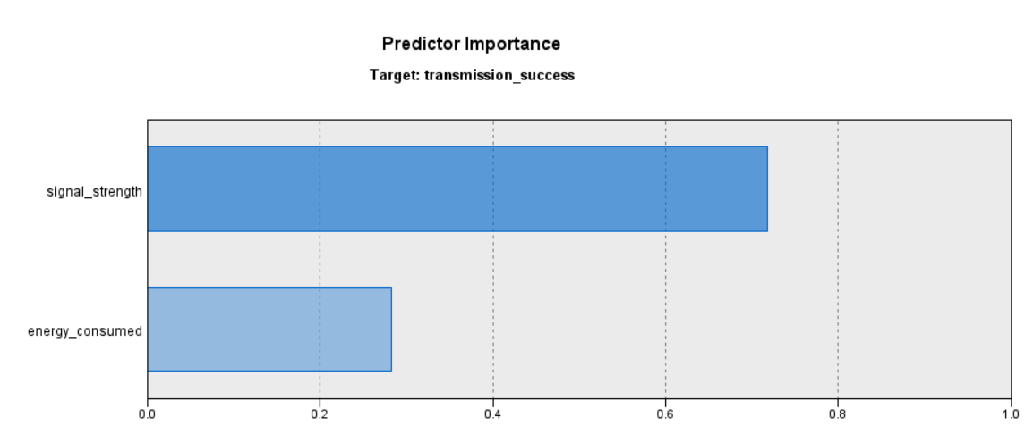
Avoid Low Signal: Do not attempt transmissions below ∼57.36 signal strength (results in 71% failure).
Optimal Mode: Reliability is maximized by the combination of high signal strength and high energy efficiency (≤1.842 J).
Wasted Power: The majority of network operations (Node 4) are likely wasting power. Energy spent above the 1.842 J threshold does not significantly improve success over the network's average. This is the biggest opportunity for energy cost reduction in the network.
KEY FINDINGS AND RESULTS
CLASSIFICATION: C5.0

Slide 4
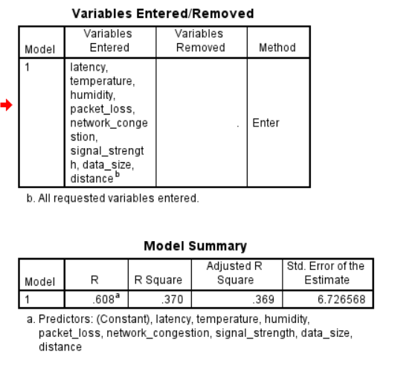
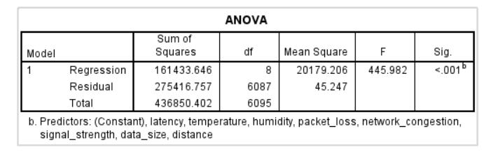
Top 3 impactful predictors:
Latency – Higher latency = more energy consumed.
Signal Strength – Better signal = less energy used.
Packet Loss – More packet loss = higher energy drain.
KEY FINDINGS AND RESULT
REGRESSION: Predictive Linear Regression

Slide 5
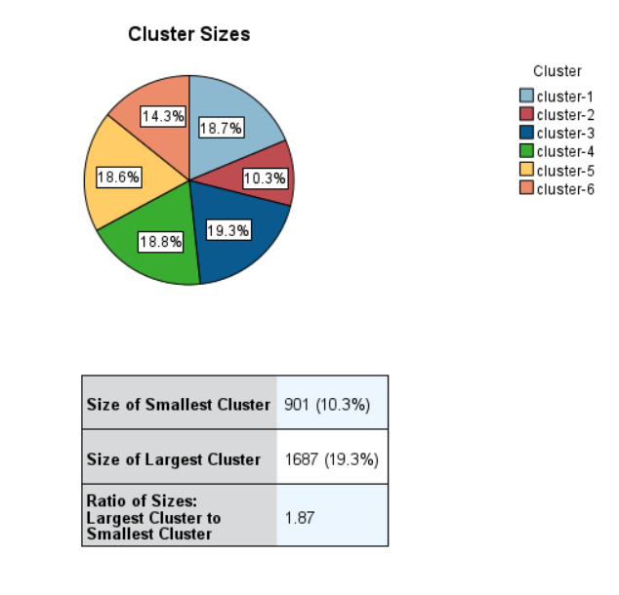
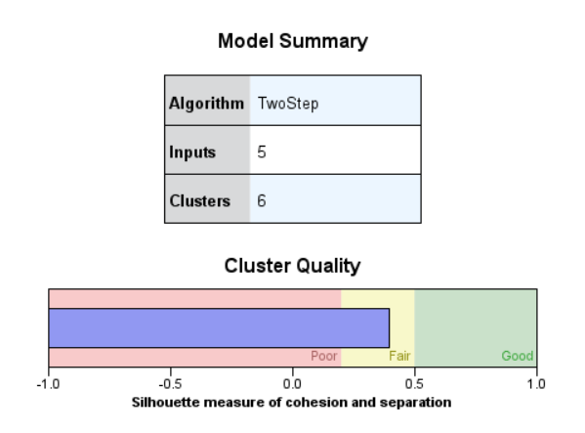
Shows the Model Summary, Cluster Quality, and their distributions.
KEY FINDINGS AND RESULTS
CLUSTERING AND REGRESSION: TwoStep and Automatic Linear Regression

Slide 6
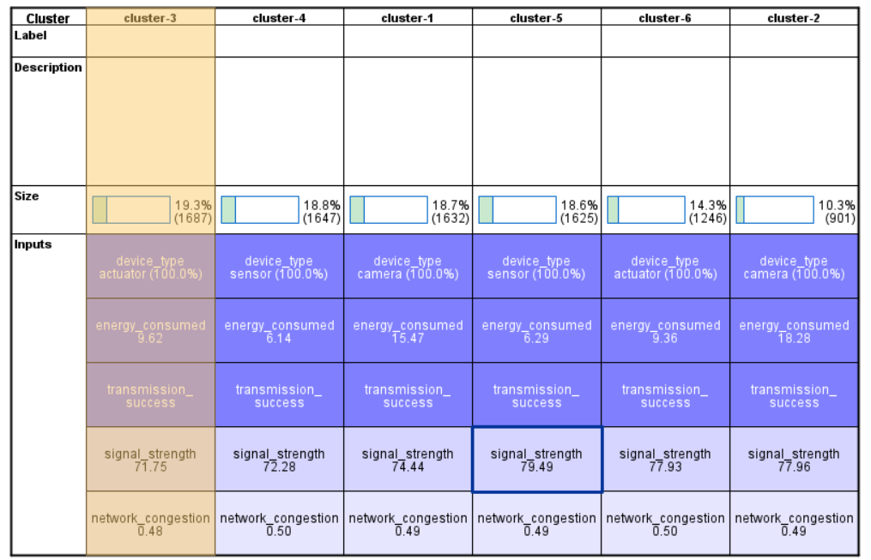
Formation of Clusters using TwoStep Clustering
KEY FINDINGS AND RESULTS
CLUSTERING AND REGRESSION: TwoStep and Automatic Linear Regression

Slide 7
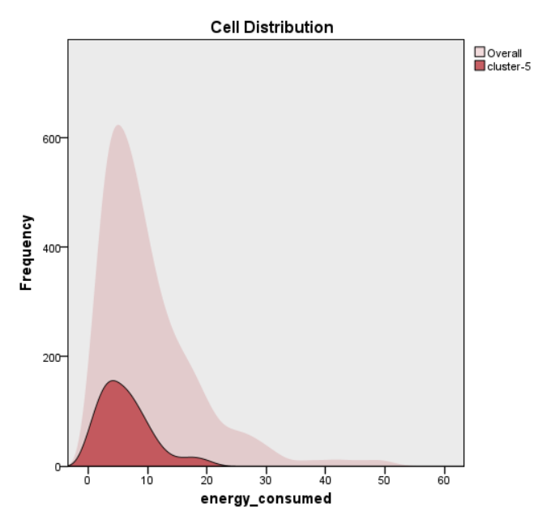
The distribution plot for Cluster 5 confirms its classification as the 'Optimal Efficiency Sensor' segment.
The segment's energy consumption is tightly clustered below 10 Joules, demonstrating a consistently high level of energy efficiency, contrasting sharply with the long-tail, high-variance consumption present in the overall network population.
KEY FINDINGS AND RESULTS
CLUSTERING AND REGRESSION: TwoStep and Automatic Linear Regression

Slide 8
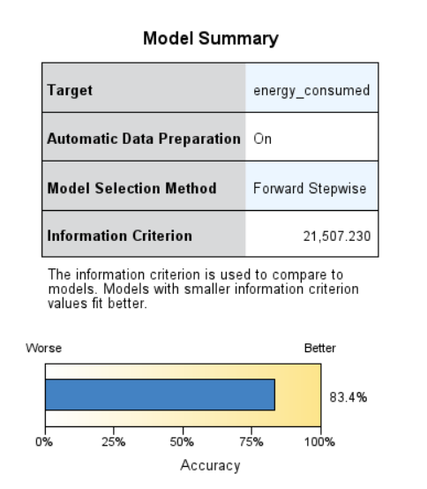
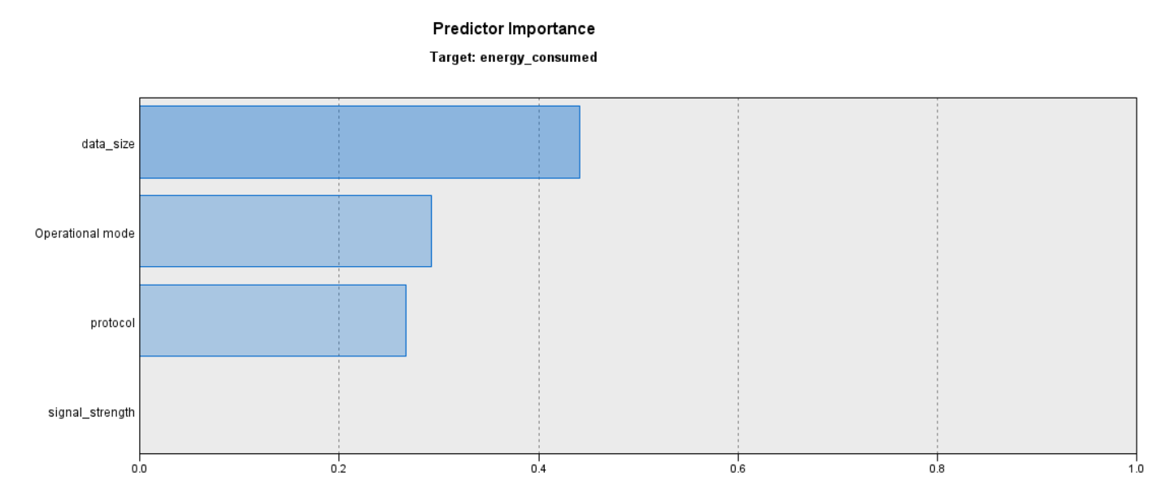
An accuracy of 83.4% is excellent for a linear regression model. Since this model predicts a continuous value, "accuracy" here refers to how closely the model's predictions align with the actual energy consumption values (likely measured by R2 or a similar fit-to-test metric). This high percentage demonstrates that your chosen input variables (distance, protocols, operational mode, etc.) are highly effective at explaining the variation in energy consumption across the network.
KEY FINDINGS AND RESULTS
CLUSTERING AND REGRESSION: TwoStep and Automatic Linear Regression

Slide 9
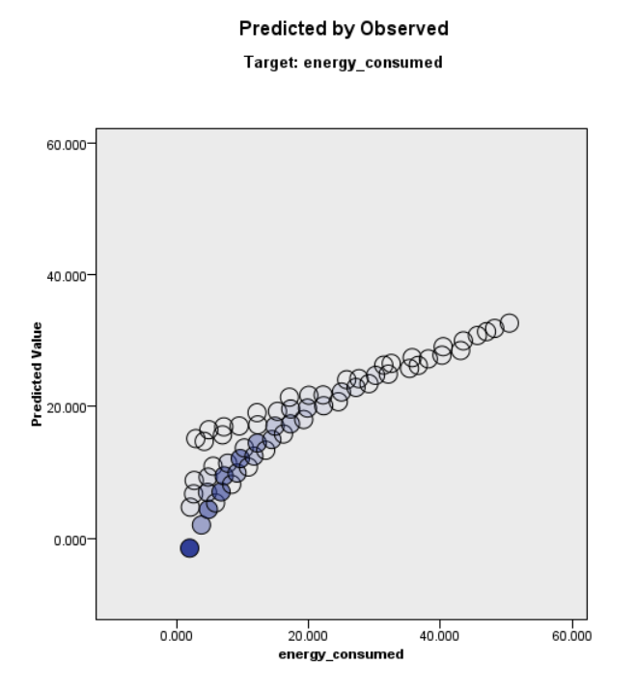
The Predicted by Observed plot confirms the high performance of the Linear Regression model, visually demonstrating a strong, near-perfect alignment between the actual and predicted energy consumption values.
The tight clustering of data along the diagonal line verifies the model's 83.4% accuracy and its robust capability to predict energy_consumed based on the key device and network characteristics
KEY FINDINGS AND RESULTS
CLUSTERING AND REGRESSION: TwoStep and Automatic Linear Regression

Slide 10
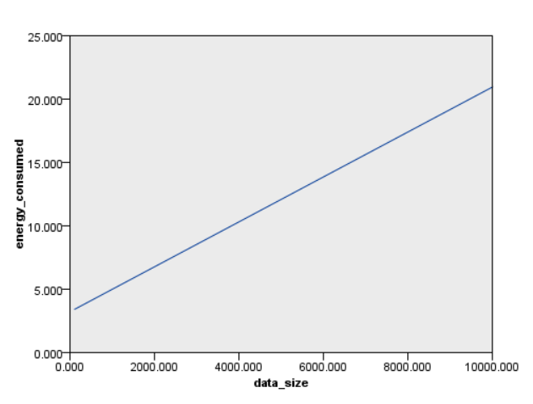
Energy_consumed vs Data_size: Following shows a graph between energy consumed in joules by a device based on the data size in bytes.
KEY FINDINGS AND RESULTS
CLUSTERING AND REGRESSION: TwoStep and Automatic Linear Regression

Slide 11
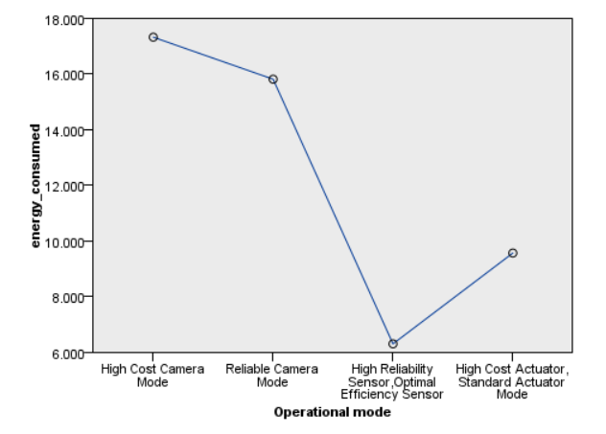
Energy_consumed vs Operational mode: Following shows a graph between energy consumed in joules by a device based on their operational mode
KEY FINDINGS AND RESULTS
CLUSTERING AND REGRESSION: TwoStep and Automatic Linear Regression
Lowest Consumption: The High Reliability Sensor, Optimal Efficiency Sensor segment is the most efficient (around 6.500 J).
Highest Consumption: The High Cost Camera Mode segment consumes the most energy (around 17.500 J)

Slide 12
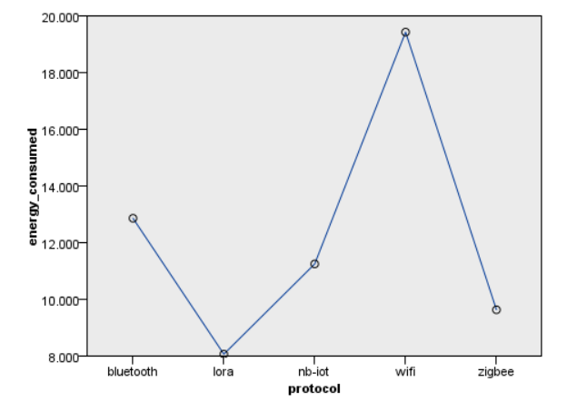
Energy_consumed vs Protocol: Following shows a graph between energy consumed in joules by a device based on their protocol
KEY FINDINGS AND RESULTS
CLUSTERING AND REGRESSION: TwoStep and Automatic Linear Regression
Most Energy Consuming: WiFi (nearly 20.000 J).
Most Energy Efficient: LoRa (just over 8.000 J). LoRa (Long Range).
Intermediate Consumers: Bluetooth, NB-IoT, and Zigbee all fall between 9.500 J and 13.000 J.

Slide 13
This project successfully leveraged a hybrid machine learning approach (Classification, Clustering, and Regression) to deliver a robust, predictive framework for optimizing IoT network performance and energy efficiency.
CONCLUSION
The models provide clear guidance: prioritize the low-power LoRa protocol where possible, segment maintenance based on the discovered operational modes, and implement a dynamic power cap to eliminate wasted energy in high-signal conditions.
These insights ensure the network can achieve greater sustainability, reduced operational costs, and extended device lifespan.

